Slide 1
Distributed File System

Slide 2
Agenda
Chapter

Slide 3
Distributed File System
Distributed File System (DFS offers a simplified way for users to access geographically dispersed files. DFS allows you to set up a tree structure of virtual directories that allows users to connect to shared folders throughout the entire network.
Administrators have the ability to take shared folders that are located on different servers and transparently connect them to one or more DFS namespaces—virtual trees of shared folders throughout an organization.
Advantages
Simplified Data Migration DFS gives you the ability to move data from one location to another without the user needing to know the physical location of the data. Security Integration Administrators do not need to configure additional security for the DFS shared folders. The shared folders use the NTFS and shared folder permissions that an administrator has already assigned when the share was set up.
Access-Based Enumeration (ABE) This DFS feature (disabled by default) displays only the files and folders that a user has permissions to access. If a user does not have access to a folder, Windows hides the folder from the user’s DFS view. This feature is not active if the user is viewing the files and folders locally.

Slide 4
Types of DFS
DFS Replication (DFSR) Replication is the process of sharing data between multiple machines. Replicated shared folders allow you to balance the load and have fault tolerance. DFS also has read-only replication folders.
DFS Namespace The DFS Namespace service is the virtual tree listing in the DFS server. An administrator can set up multiple namespaces on the DFS, allowing for multiple virtual trees within DFS.

Slide 5
Database Cloning
This new feature allows administrators to accelerate replication when creating folders, servers, or recovery systems.
Administrators will now have the ability to extract the DFS database from a single DFS server and then clone that database to multiple DFS servers.
The Export-DfsrClone cmdlet to export the volume that contains the DFS database and configuration .xml file settings.
The Import-DfsrClone to import the data to a specific volume. The service will then validate that the replication was transferred completely.

Slide 6
Recovering a DFS Database
DFS database recovery is a feature that allows DFS to detect a corrupted database, thus allowing DFS to rebuild the database automatically and continue with normal operations of DFS replication.
One advantage to this is that when DFS detects and fixes a corrupt database, it does so with no file conflicts.

Slide 7
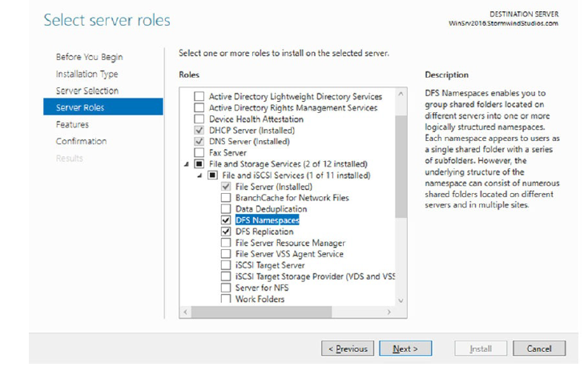
Installing the DFS Namespace service

Slide 8
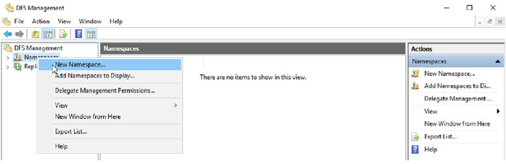
Setting up a DFS namespace
Open DFS Management (Start Administrative Tools DFS Management).
Right-click Namespaces and choose New Namespace.
In the Server box, enter the name of the server that will host this namespace. Click Next.

Slide 9
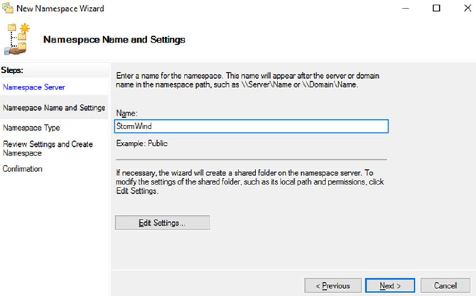
Setting up a DFS namespace
4. At the Namespace screen, enter the namespace you want to use and
hit the Next button.
5. Under Namespace Type screen, choose Stand-Alone or Domain Based and click Next.
6. At the Review Screen, click Create.
7. Click the Close button. Leave DFS open.
8. Go to Windows Explorer by hitting the Windows Key + E.
9. Create a new folder called Home and share the folder.

Slide 10
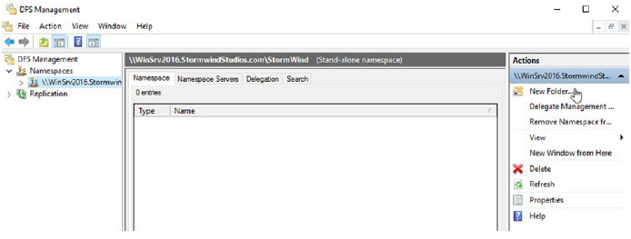
Setting up a DFS namespace
10. In DFS under the Actions section (right hand side), choose New Folder.
11. When the New Folder screen appears, Type in the Name for this folder and then hit Add.
12. Add the shared Home Folder and hit OK.

Slide 11
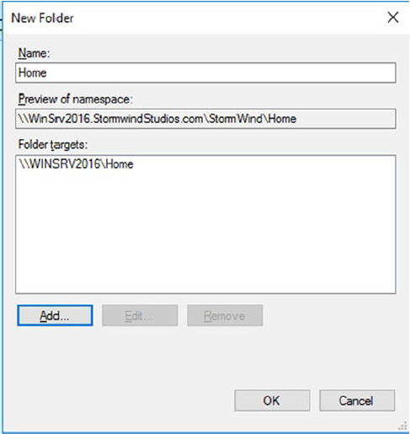
Setting up a DFS namespace
13. After you have entered a name and put in the Home folder, click OK.
14. The namespace has been created and you have added a shared folder to the namespace. Add any of your other shared folders and then close DFS.

